Slide 1
MEDTRACK DV
HOSPITAL OPERATIONS & ANALYTICS DASHBOARD
Project Journey: Milestone 1 → Milestone 2 → Milestone 3

Slide 2
PROJECT OVERVIEW
01
02
03
Milestone 1
Milestone 2
Milestone 3
Initial project work, data understanding and preparation.
Further data analysis and dashboard development.
Improvement and completion of an interactive multi-dashboard Power BI solution.

Slide 3
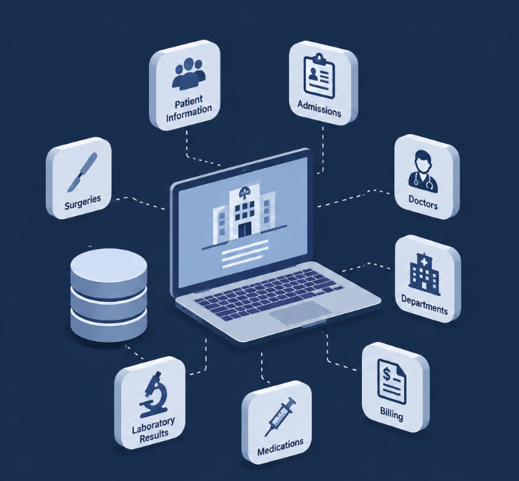
DATASETS COLLECTED
Eight datasets
Patient Information
Admissions
Doctors
Departments
Billing
Surgeries
Medications
Laboratory Results

Slide 4

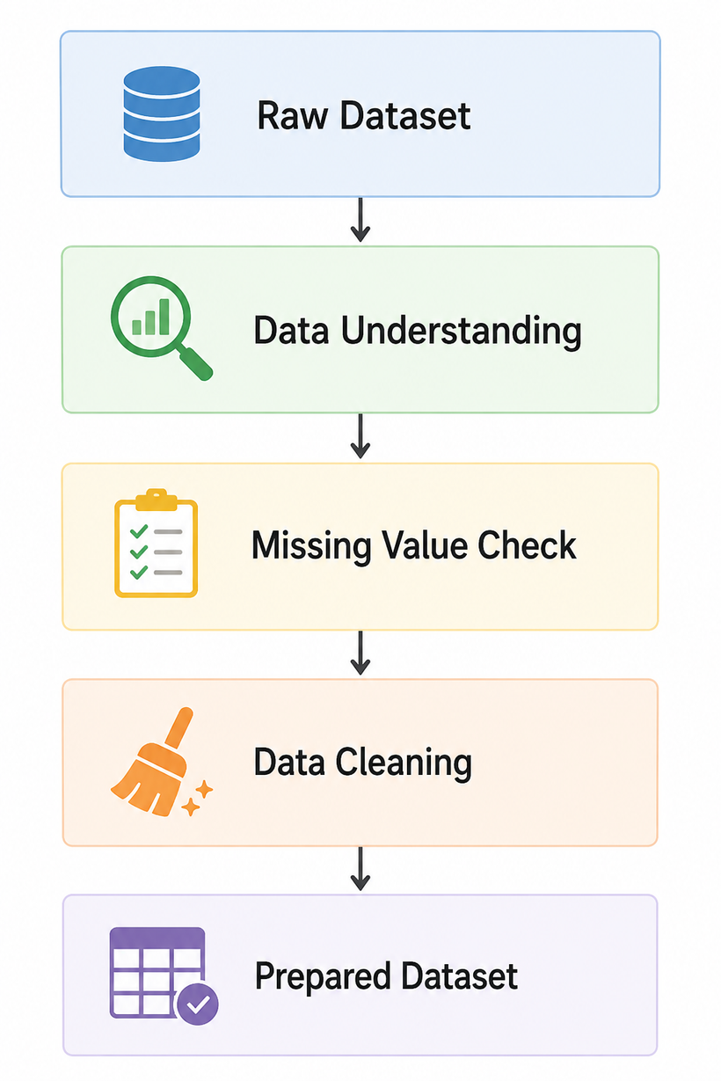
MILESTONE 1
Data Preparation
During the initial stage, the focus was on understanding and preparing the hospital dataset for analysis.
The work included :-
  Exploring the available dataset and its features.
  Checking the dataset structure and data types.
  Checking for missing values.
  Performing data cleaning.
  Preparing the dataset for further analysis.

Slide 5
Data Cleaning Process
The dataset was checked and prepared before moving to analysis and dashboard development.
The main activities included:
  Identifying missing values.
  Handling data quality issues where required.
  Checking the data before further analysis.
  Preparing the data for visualization.
Tools used:
  Pandas
  NumPy

Slide 6
FEATURE ENGINEERING
Additional features were created to support better analysis and visualization.
  Admission_Day
  Admission_Month
  Admission_Month_No
  Admission_Quarter
  Admission_Year
  Age_Group
  Weekend_Admission
  Stay_Category
These features helped in analyzing the data from different perspectives.
Examples of features used in the project include:-

Slide 7
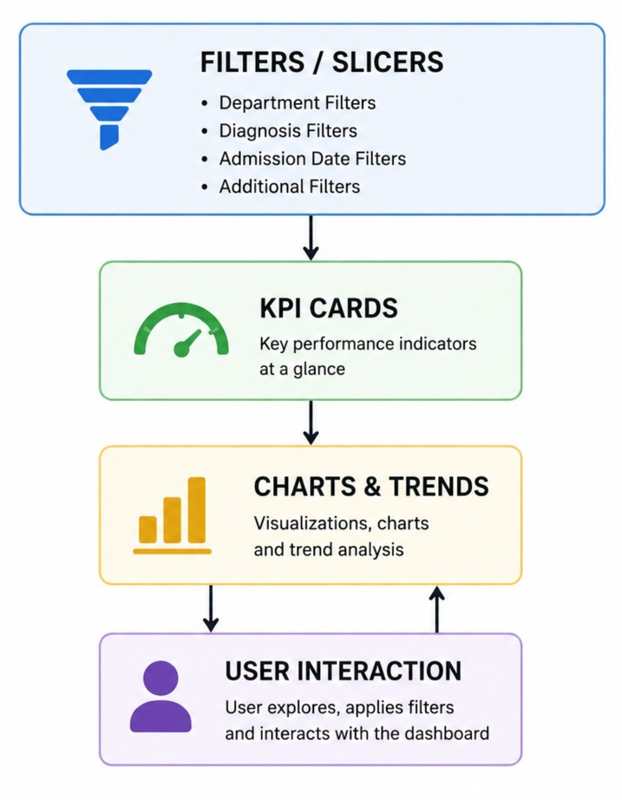
MILESTONE 2 – DASHBOARD DEVELOPMENT
In Milestone 2, the prepared data was used to develop Power BI dashboards.
The dashboard work focused on:
  Creating KPI cards.
  Adding charts for hospital analysis.
  Using filters and slicers.
  Analyzing admissions, departments, diagnosis, revenue, and other available hospital metrics.

Slide 8
MILESTONE 2
Interactive Dashboard Features
The Power BI report included interactive elements such as:
  Department filters
  Diagnosis filters
  Admission Date filters
  Additional filters based on each dashboard, such as Gender, Ward, Bed Type, and Floor
The Power BI report included interactive elements such as:
  Department filters
  Diagnosis filters
  Admission Date filters
These filters allow users to interact with the dashboard and view insights based on selected values.

Slide 9
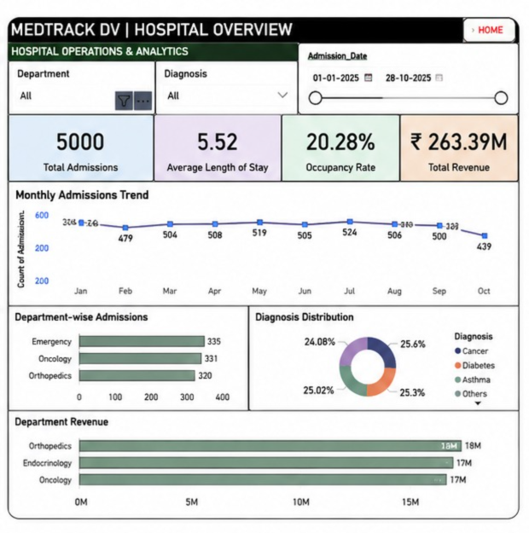
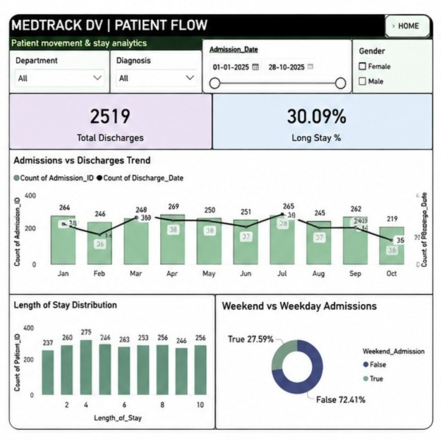


MILESTONE 2: POWER BI DASHBOARD DEVELOPMENT
Four Interactive Dashboards Created
1. Hospital Overview
2. Patient Flow
  Overall hospital performance
  Admissions, occupancy, revenue, and diagnosis insights
  Admissions and discharges trend
  Length of stay analysis
  Weekend vs weekday admissions

Slide 10
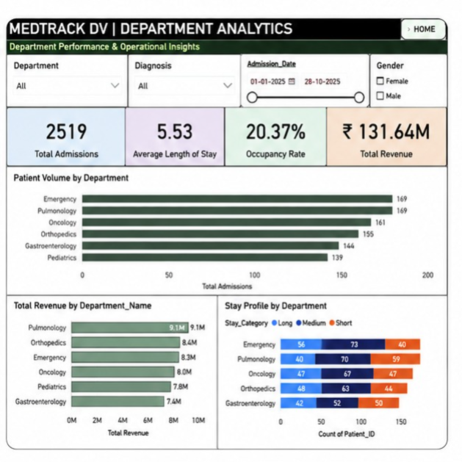
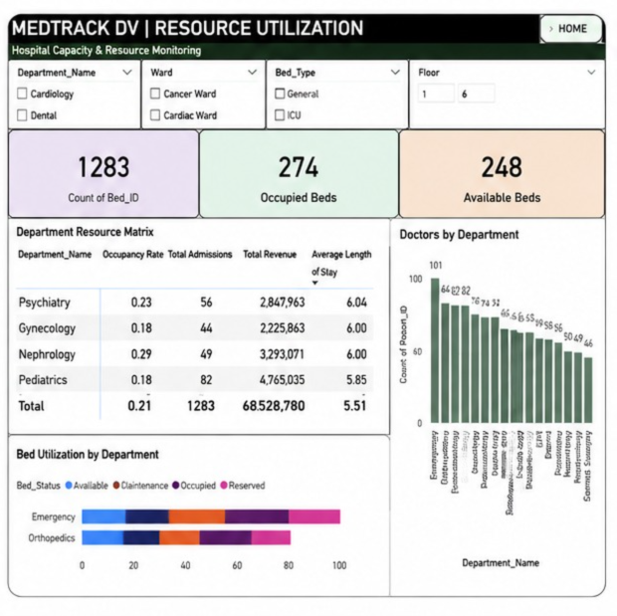
MILESTONE 2: POWER BI DASHBOARD DEVELOPMENT
Four Interactive Dashboards Created
3. Department Analytics
4. Resource Utilization
  Patient volume by department
  Department-wise revenue
  Stay profile analysis
  Total, occupied, and available beds
  Department resource matrix
  Doctors and patient stay analysis

Slide 11
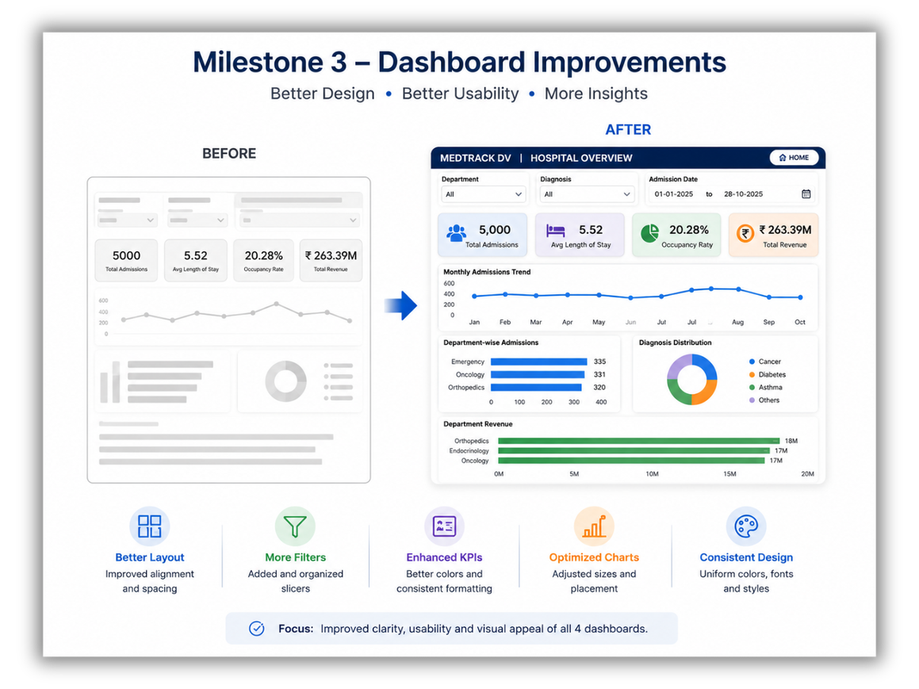
MILESTONE 3 – DASHBOARD IMPROVEMENTS
Main focus: Improving the design and presentation of the dashboards created in Milestone 2.
  Improved the dashboard layout and alignment.
  Added additional filters/slicers where required.
  Improved KPI card colors and formatting.
  Adjusted chart sizes and placement for better clarity.
  Made titles, labels, and colors more consistent.
  Improved the overall look and usability of all 4 dashboards.

Slide 12
LEARNING OUTCOMES
Milestone 1 – Data Preparation
Milestone 2 – Dashboard Development
Milestone 3 – Dashboard Improvement
  Data understanding
  Missing value analysis
  Data cleaning
  KPI and DAX creation
  Interactive dashboards
  Charts, filters & slicers
  Better layout & alignment
  Improved colors & formatting
  Visual consistency & readability

Slide 13
THANK YOU

